Slide 1
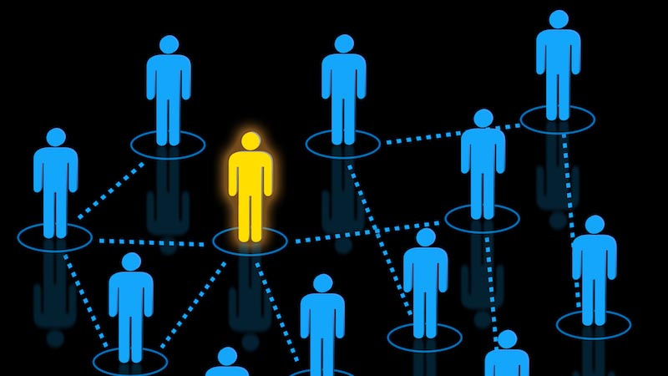
Rajiv Gandhi University of Knowledge Technologies
Basar
Department of Computer Science and Engineering
CAMPUS CONNECT
We are here to connect you!!

Slide 2

1.MOTIVATION
2.PROJECT DESIGN
CONTENTS
3.TECH STACK
4.IMPLEMENTATION
5.CONCLUSION

Slide 3

MOTIVATION
The motivation behind this project stems from the lack of proper communication in our campus premises.
Given that our university accommodates around 10,000 students,it’s understandable that one can’t connect to each and everyone at a time.
This leads to significant delays in contacting a group or community at a time.
To solve the conncecting problem in the campus efficiently and accurately,we have developed a unique solution.

Slide 4

User
PROJECT DESIGN
Sign Up
Successfull
Invalid Login
SIGN UP
Login
Use Application

Slide 5

User
Invalid Login
LOGIN
Login
Successfull
Create Posts
Post is added to
the the application

Slide 6
Created post
Low
Number of
views
High
Message is added to
the ON THE TOP

Slide 7






TECH STACK
FRONTEND
BACKEND

Slide 8
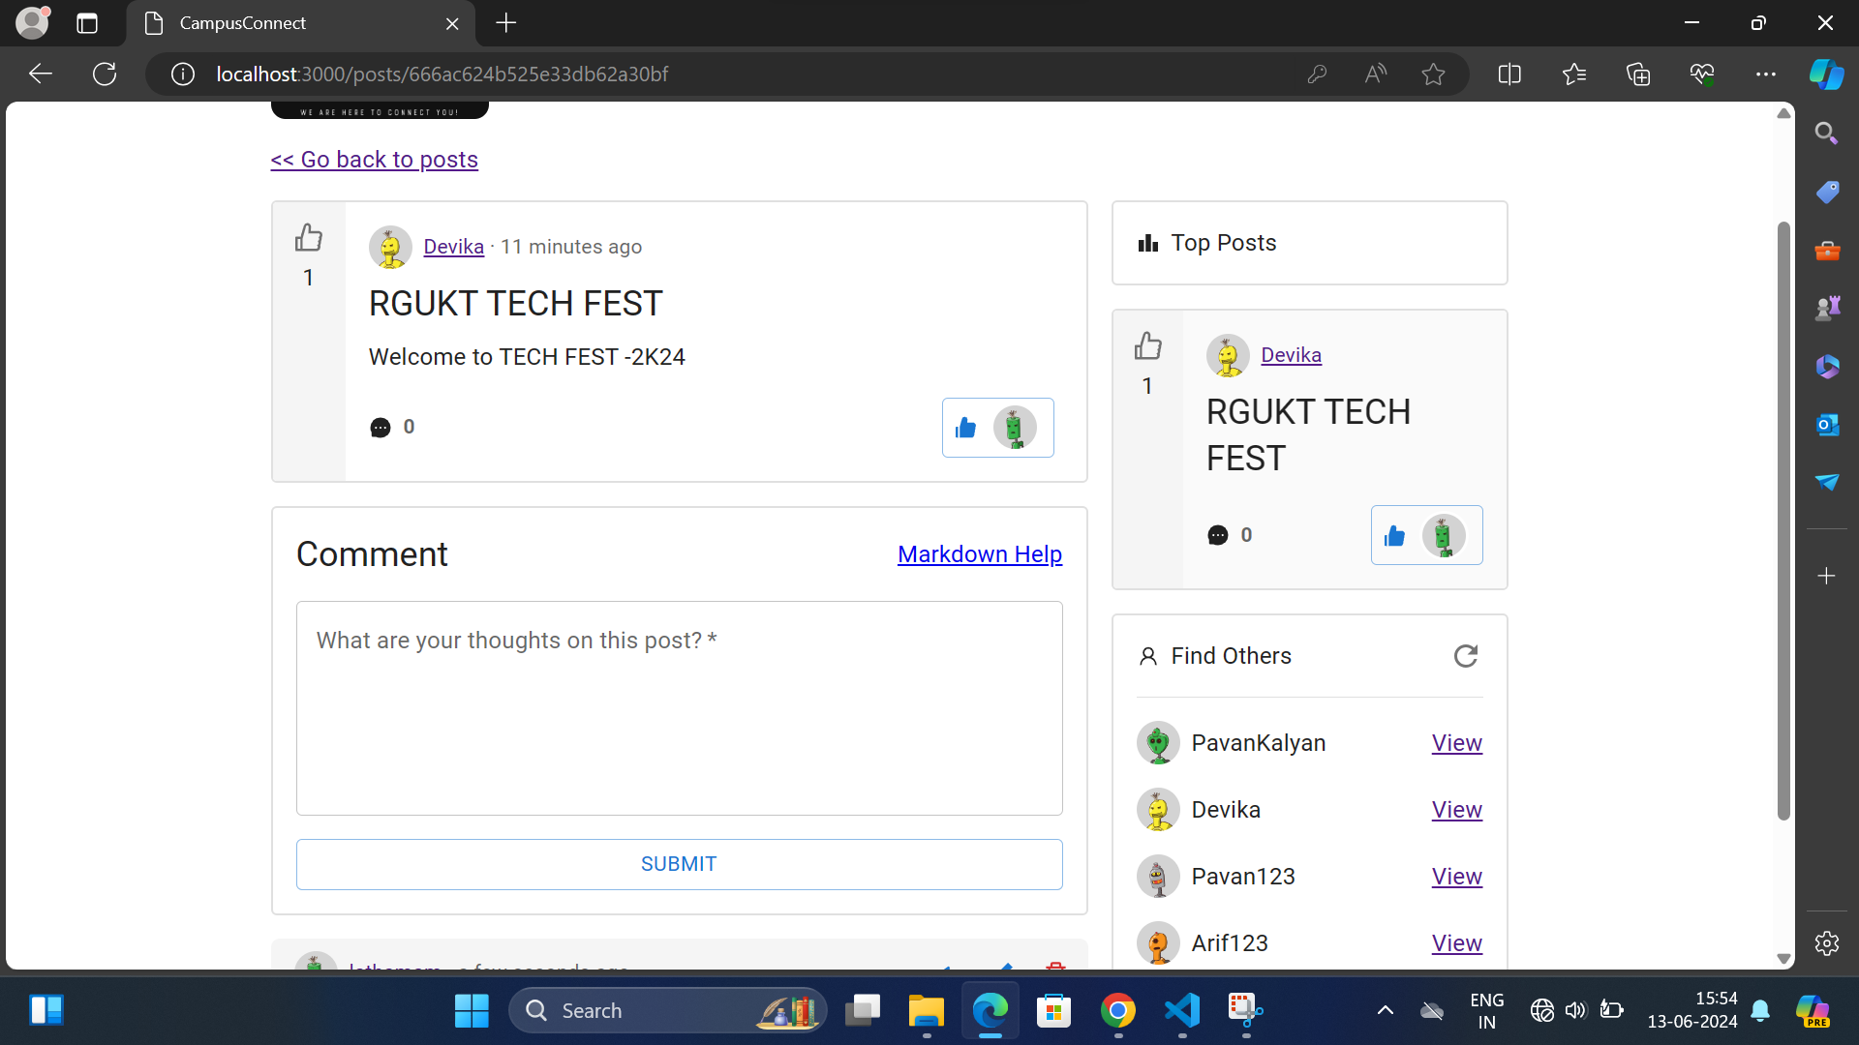
IMPLEMENTATION
The homepage of CAMPUSCONNECT Application.

Slide 9
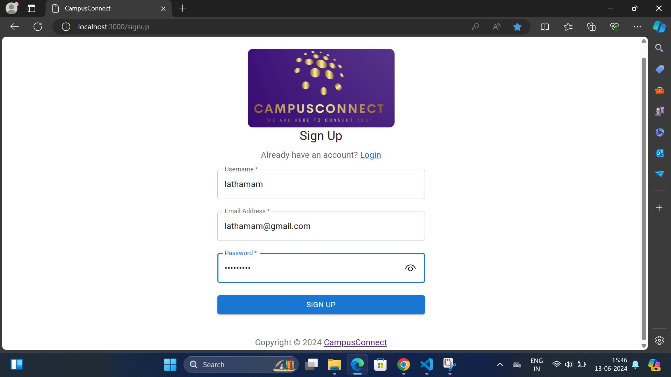
To post some messages in the application one need to be an identified user,if
not he/she need to be sign up first to use the campusconnection application.

Slide 10
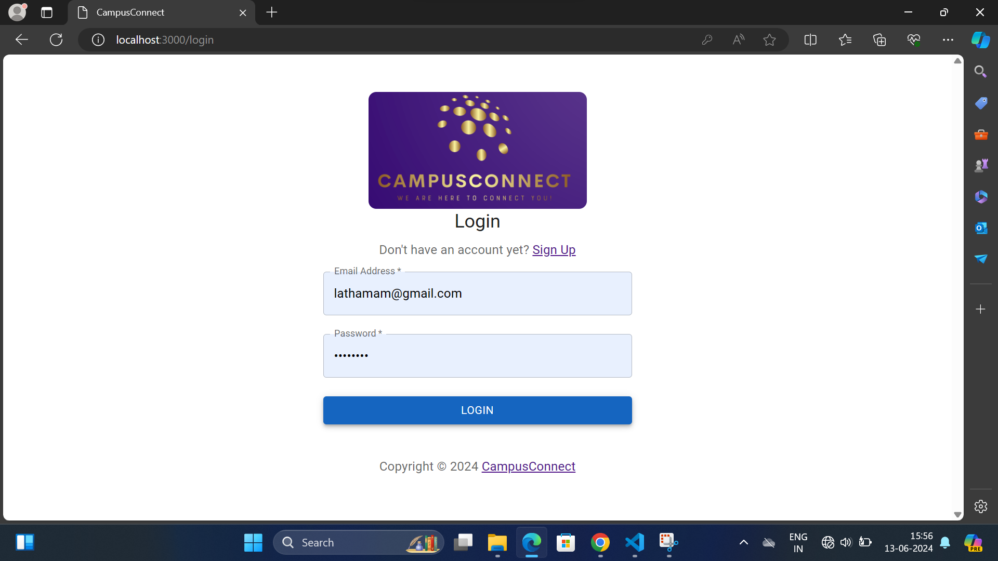
After Sign Up,user need to login with Email and Password to access the application to create post and to comment on the created posts.

Slide 11
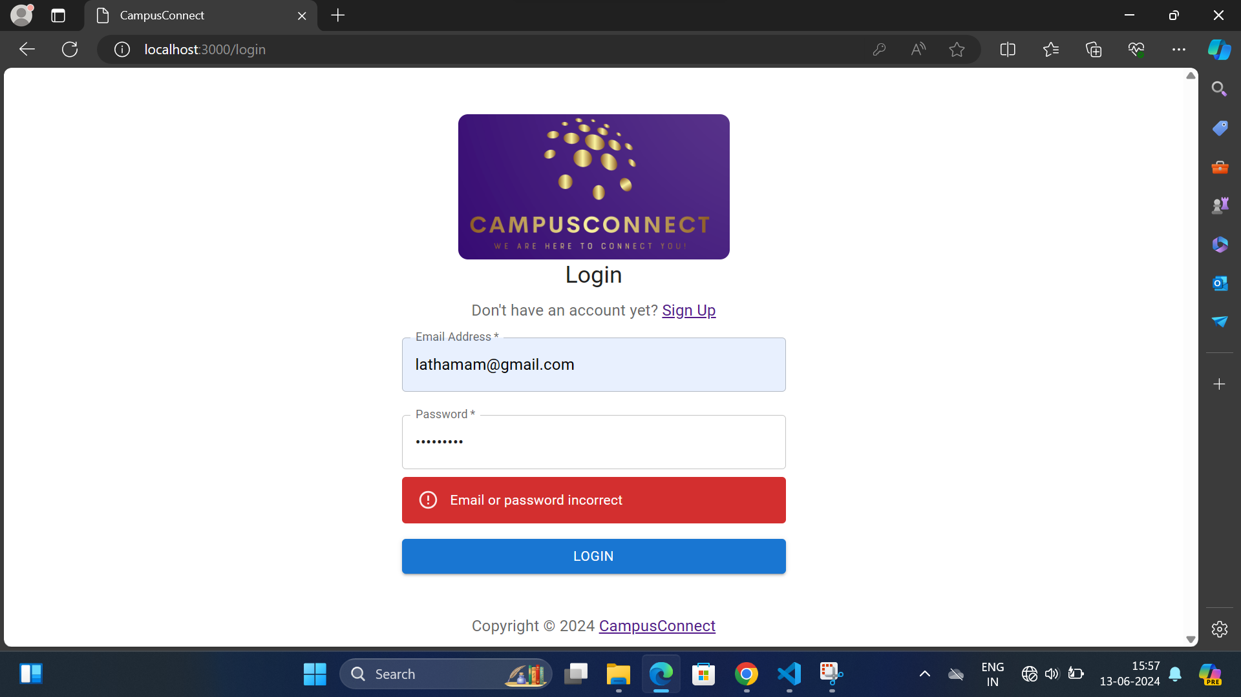
If the Email address or password is incorrect user is not allowed to login to the application.

Slide 12
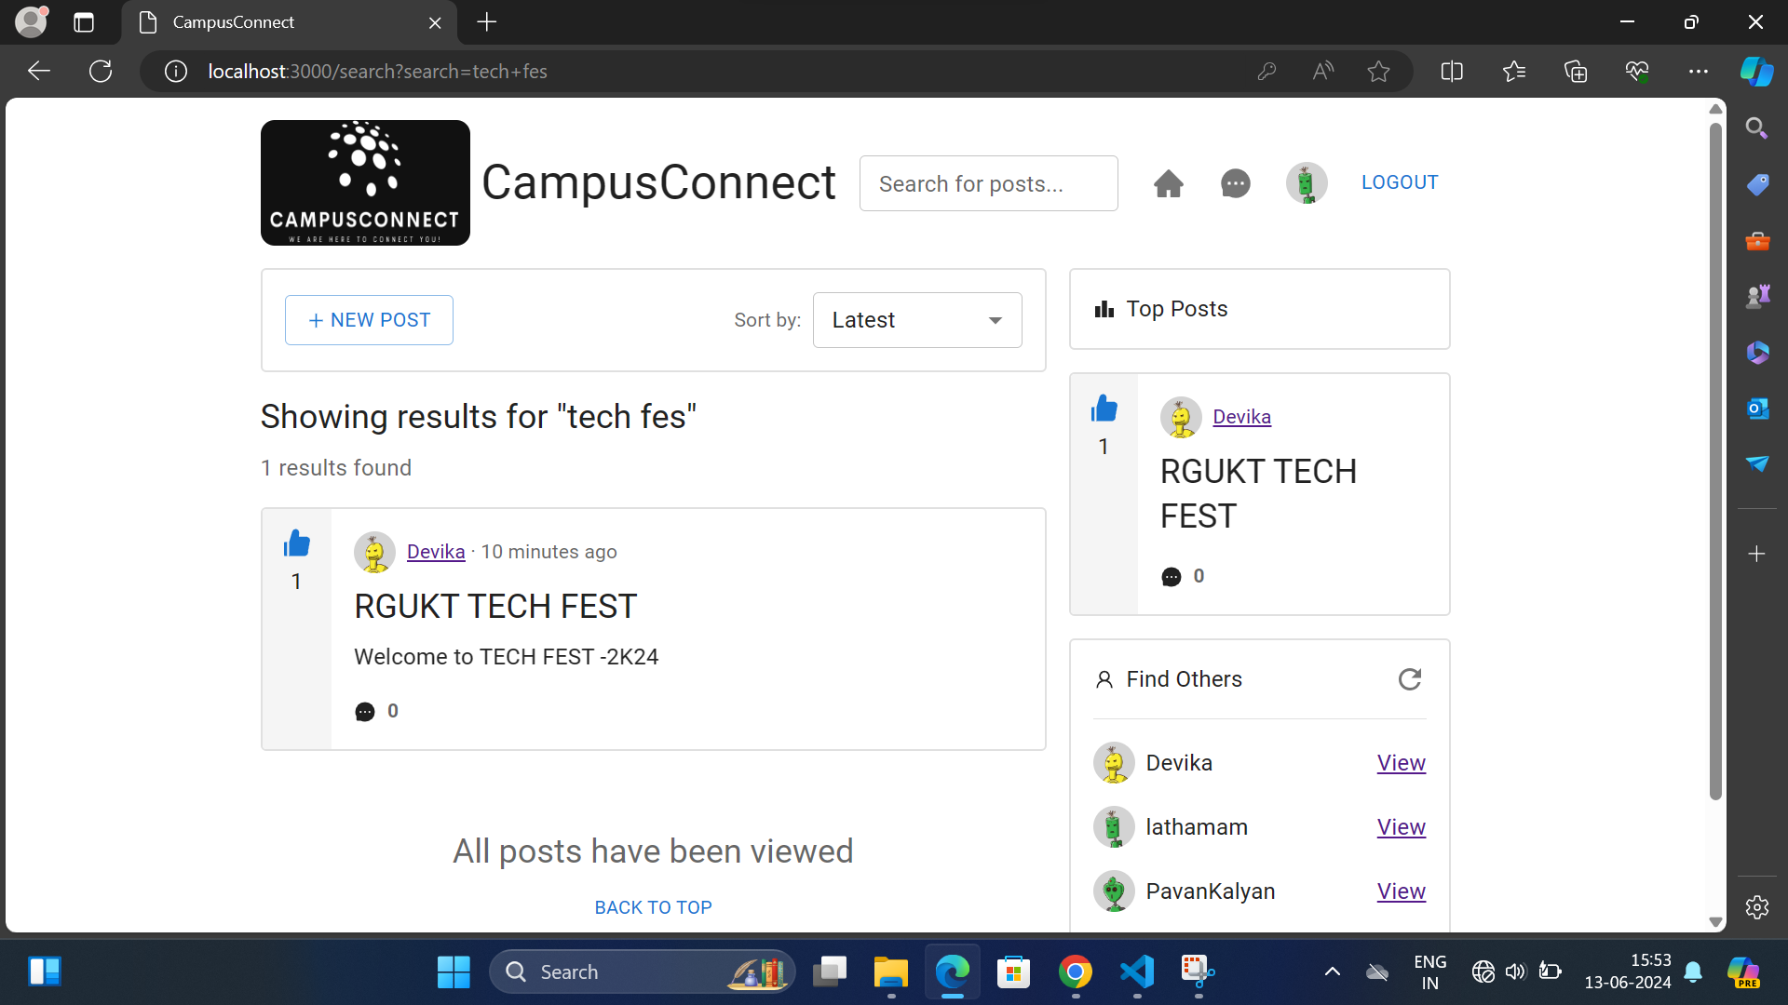
After logged in user has the access to create/add new posts.

Slide 13
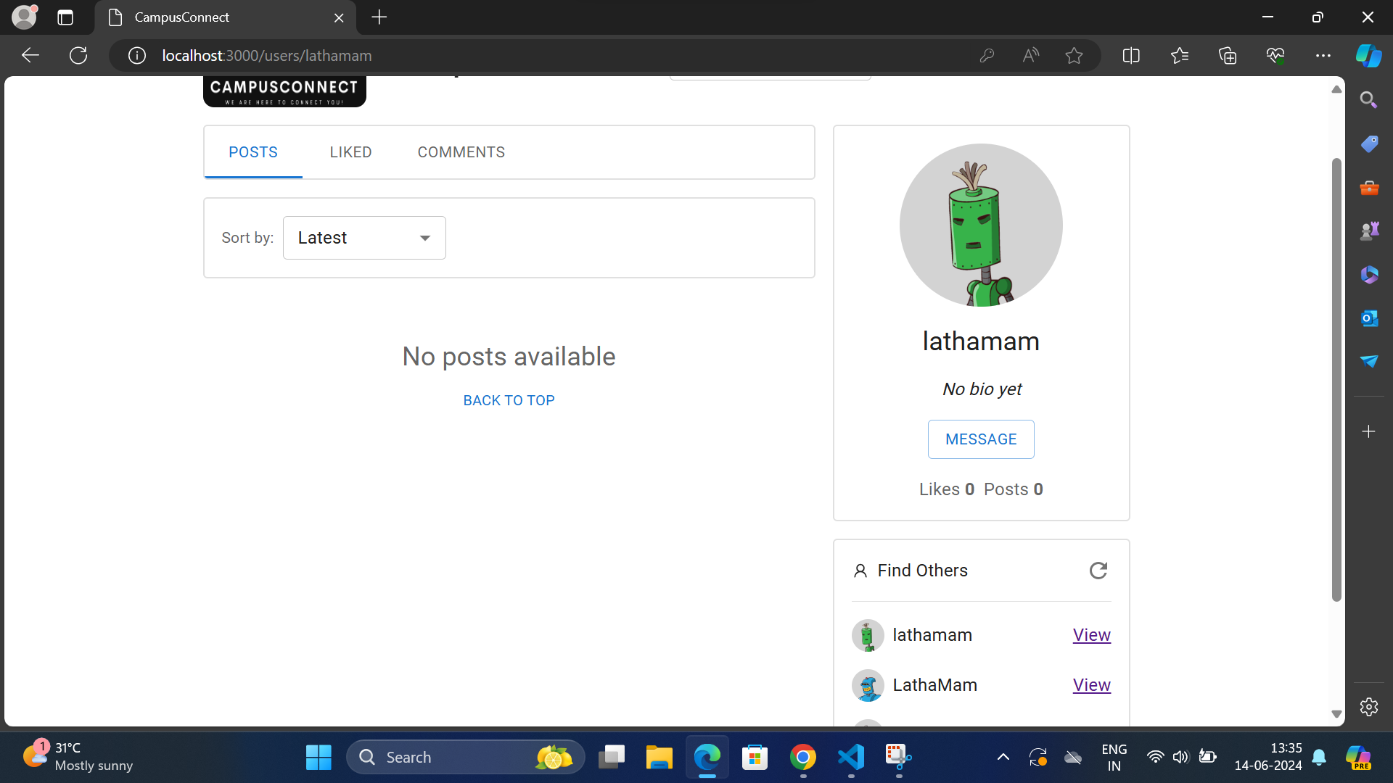
Once the new post has been created ,users are allowd to view the posts.

Slide 14

Users are allowed to view the added posts in the chronological order

Slide 15
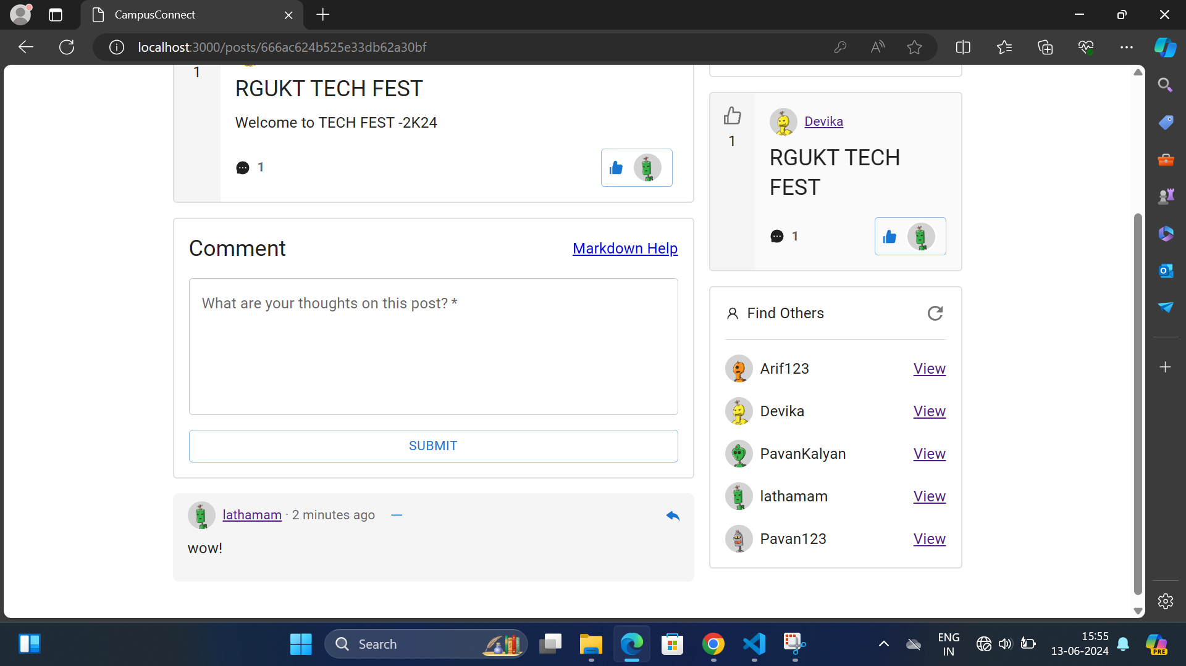
Users are allowed to comment on the added posts.

Slide 16
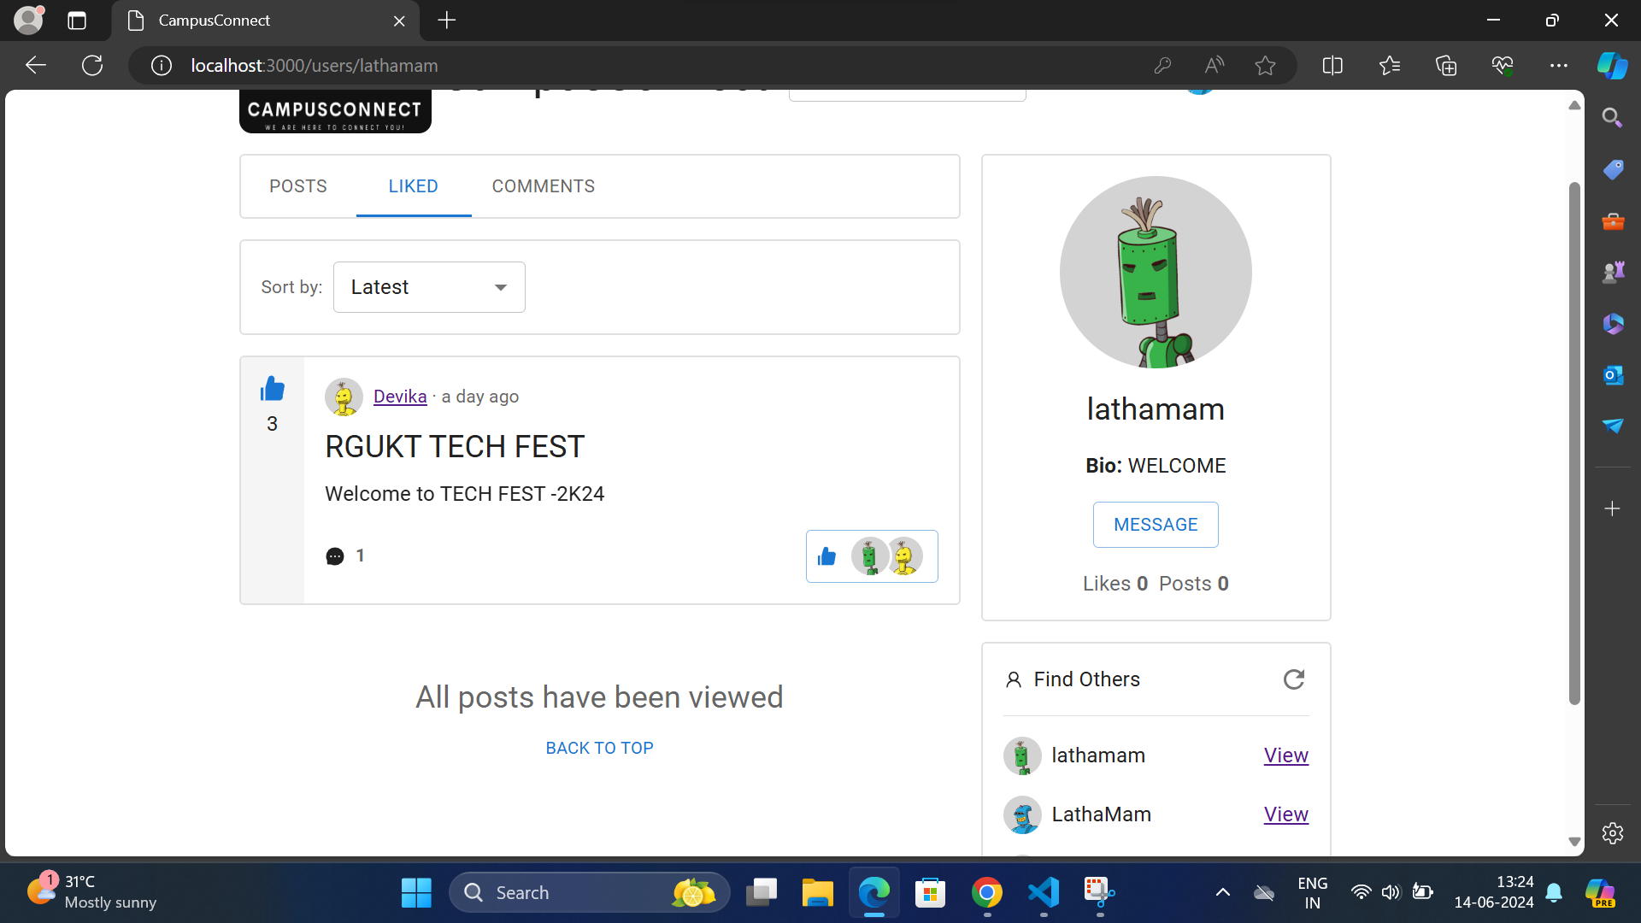
Users are availed to like the posts .

Slide 17
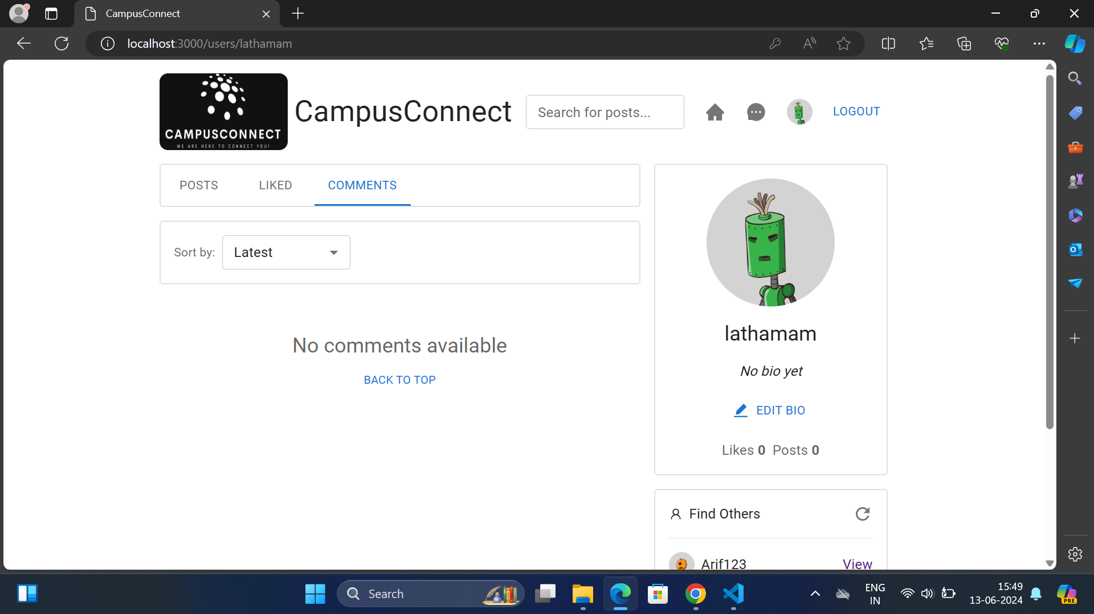
Users are allowed to read the comments added to the posts.

Slide 18
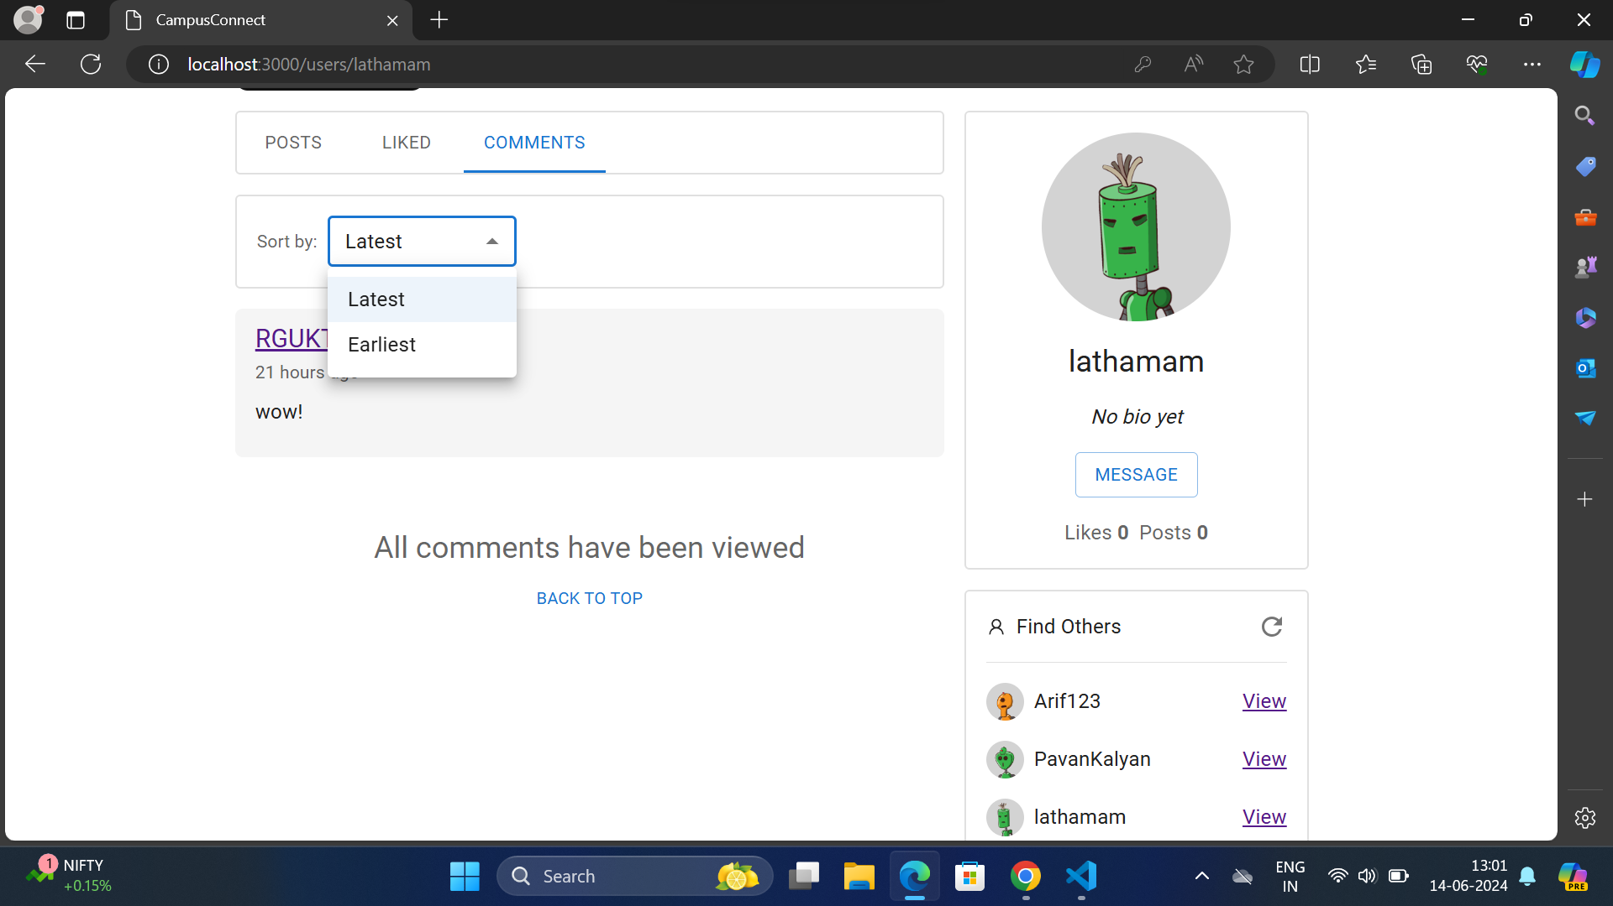
Users can search the comments in a specified mannerr.

Slide 19
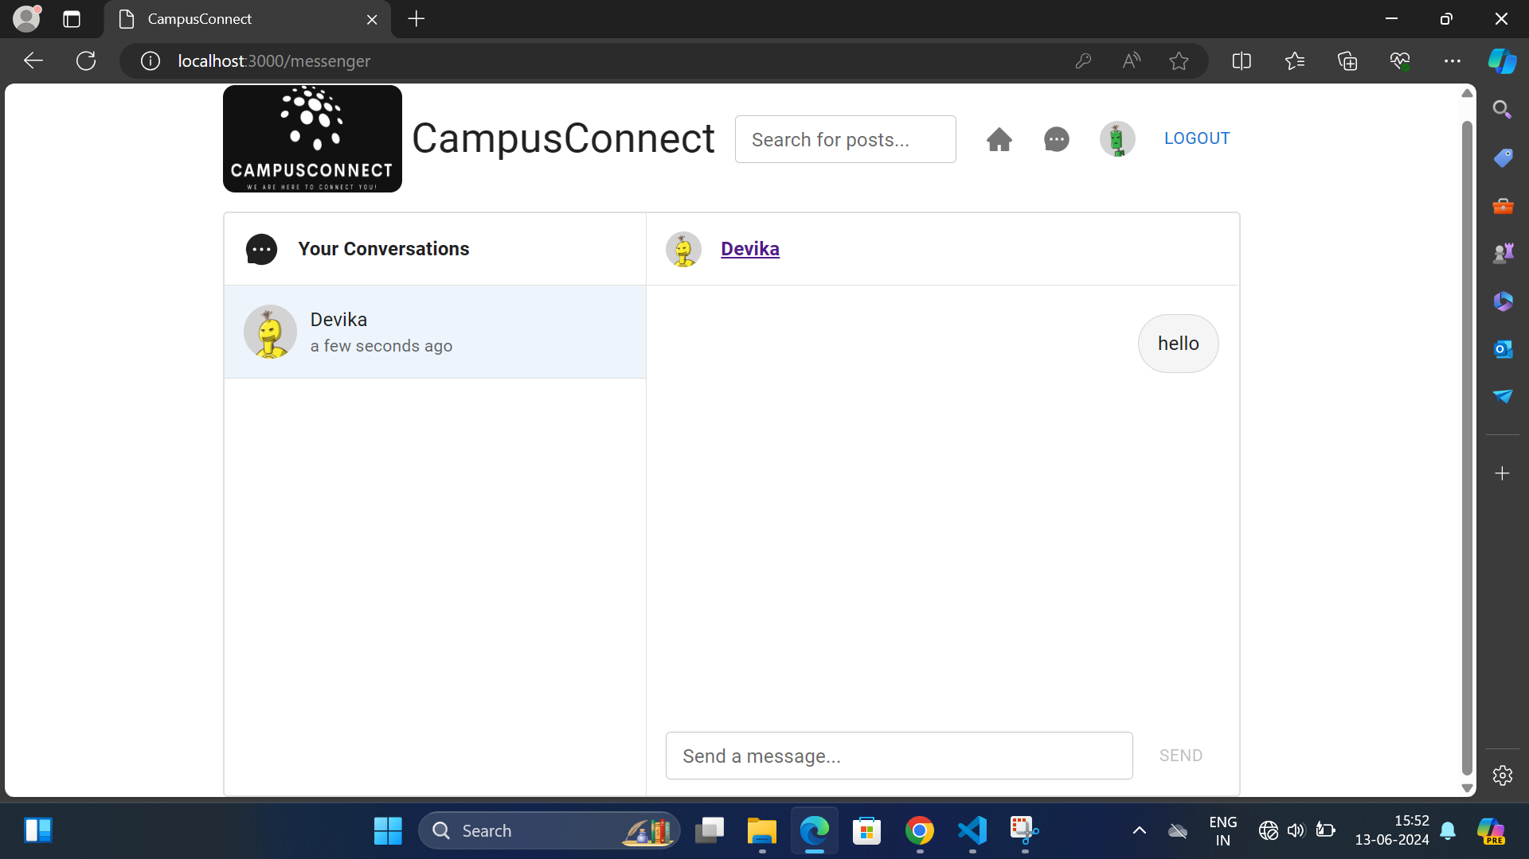
Users are allowed to text messages to other participants privately.

Slide 20
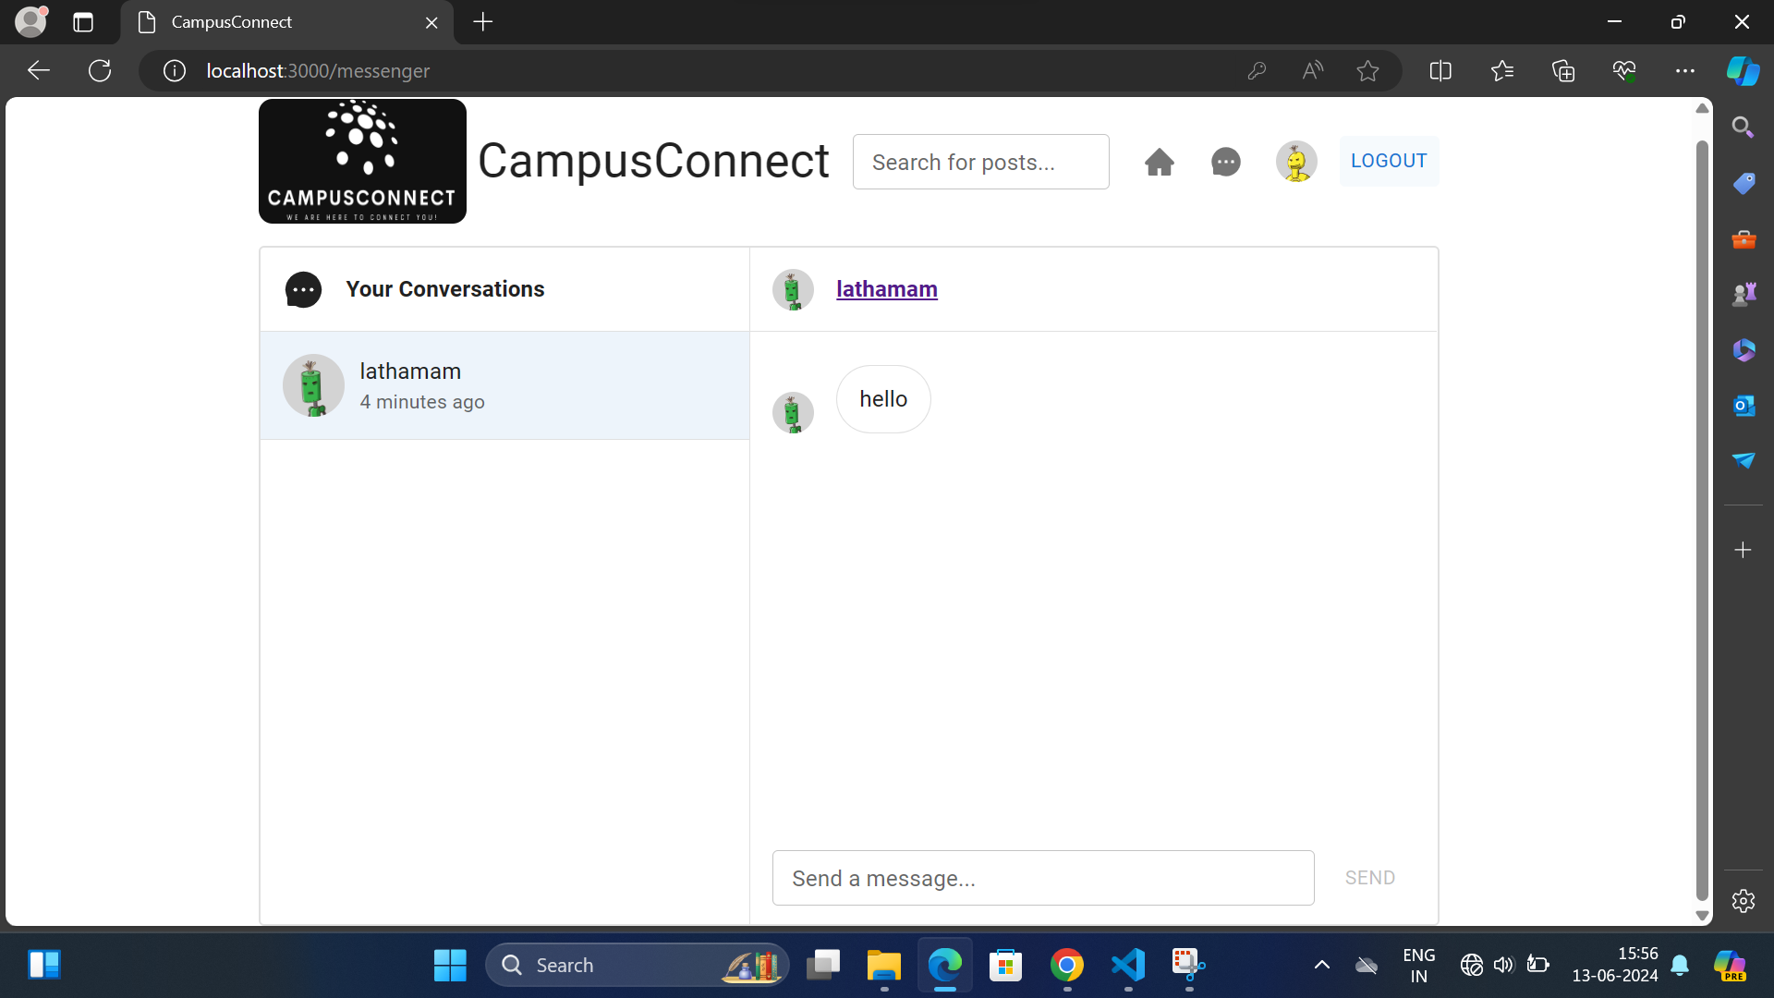
Users can view the messages in their personal chatbox.

Slide 21
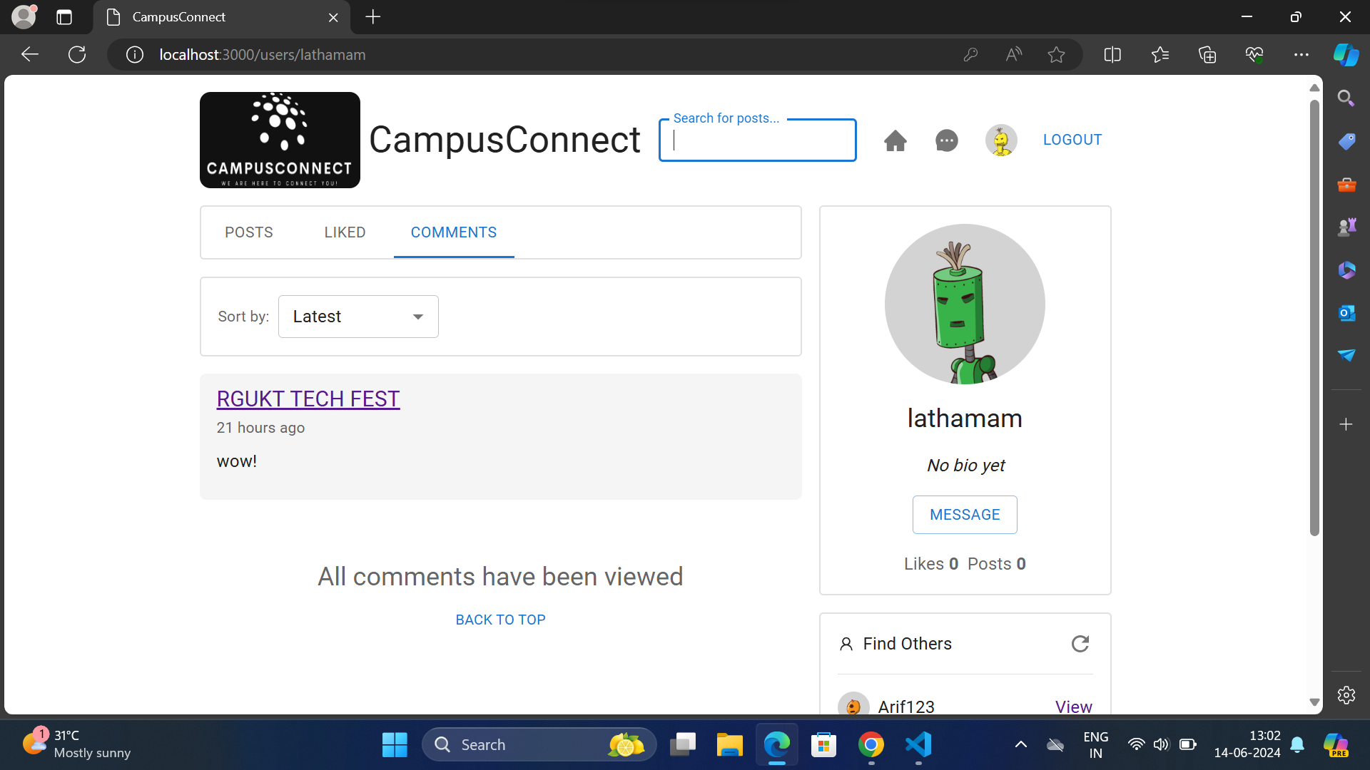
Users are availed with search option to search their desired post.

Slide 22
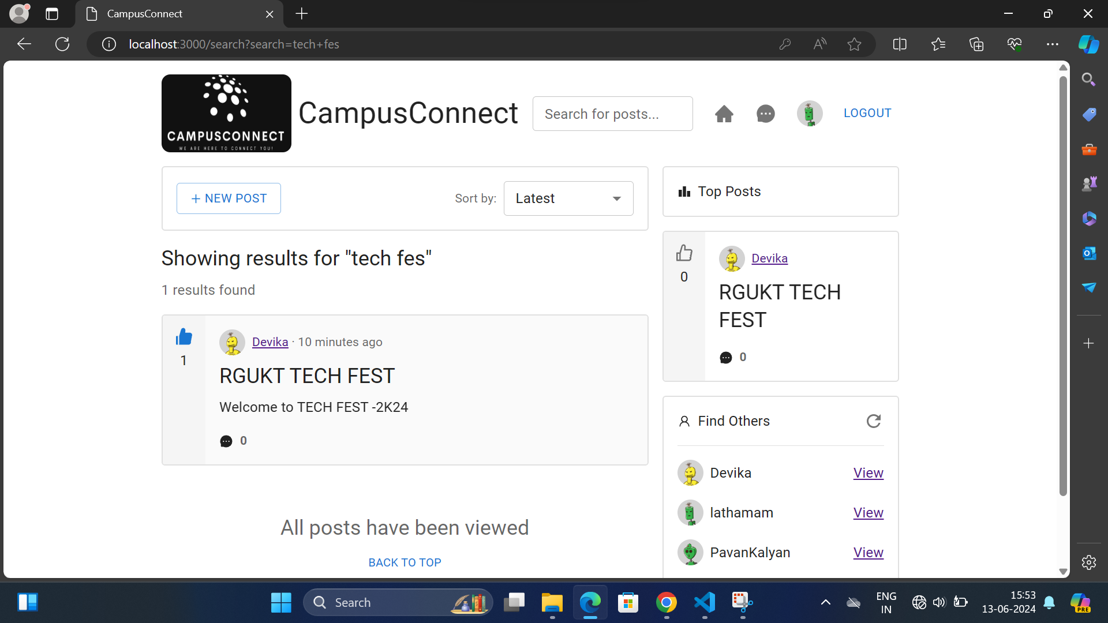
Showing the search results.

Slide 23
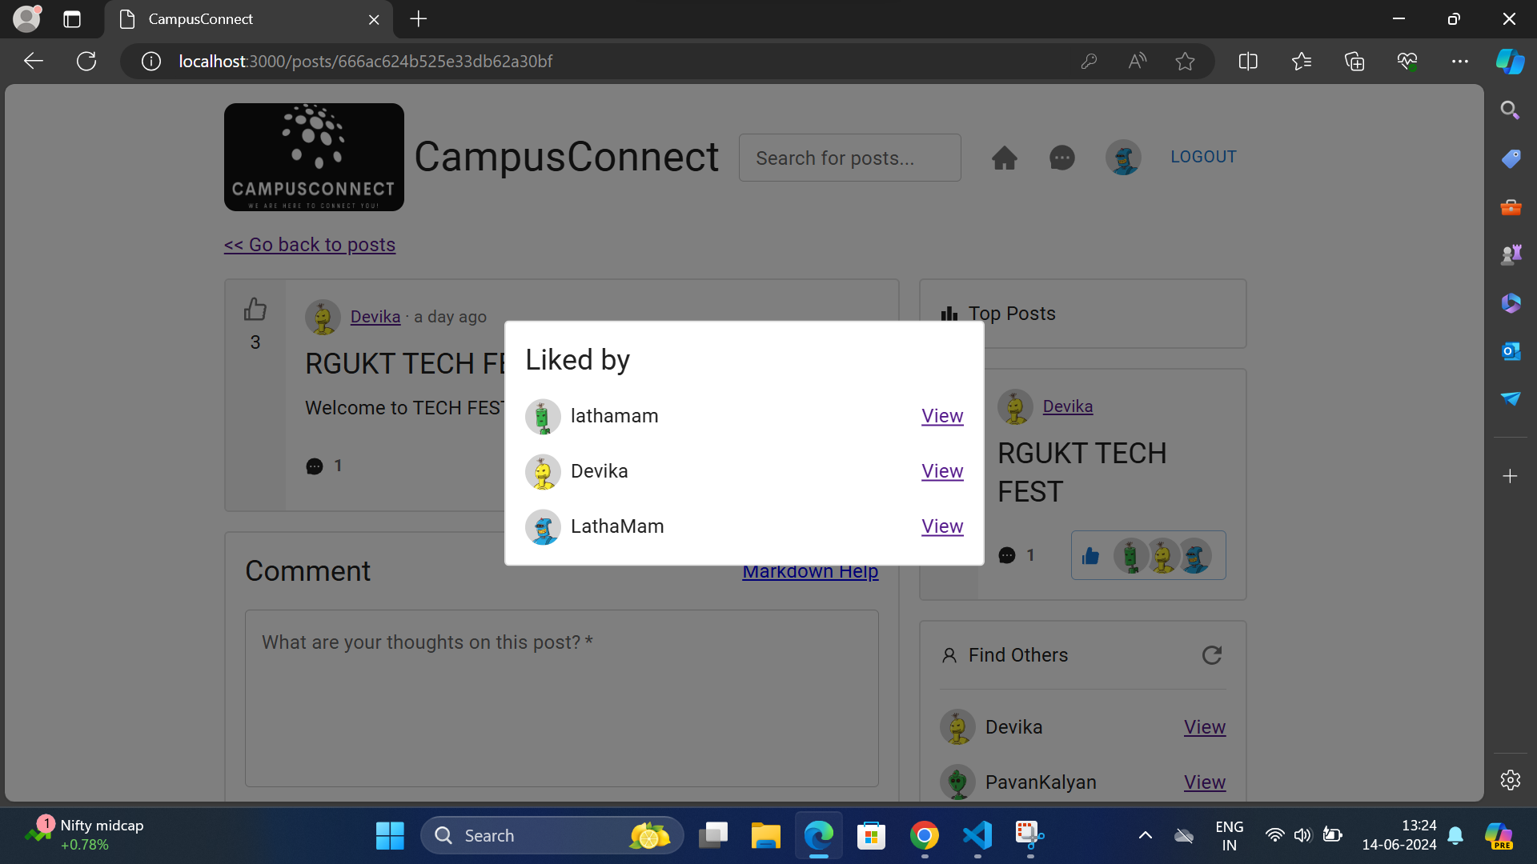
Participants can view the status of individuals who had liked a particular post.

Slide 24
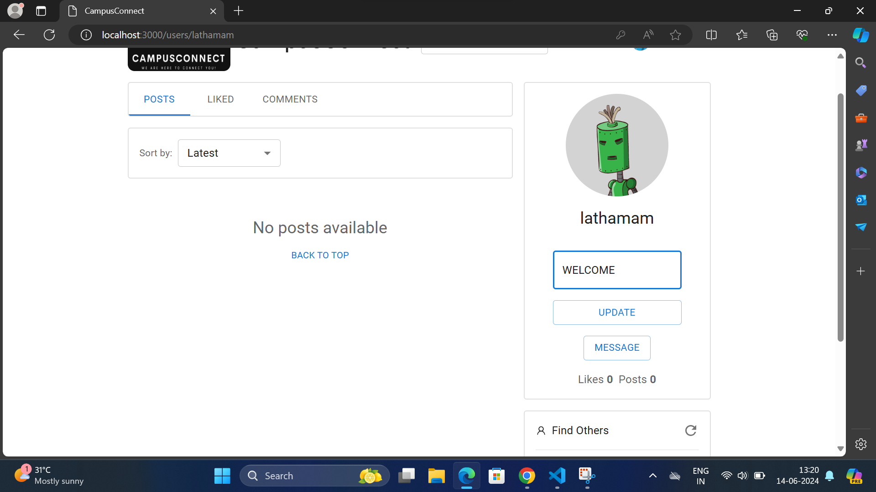
Every participant of the application is allow to add their BIO and also allowed to UPDATE their BIO.

Slide 25
One can view the updated BIO .

Slide 26
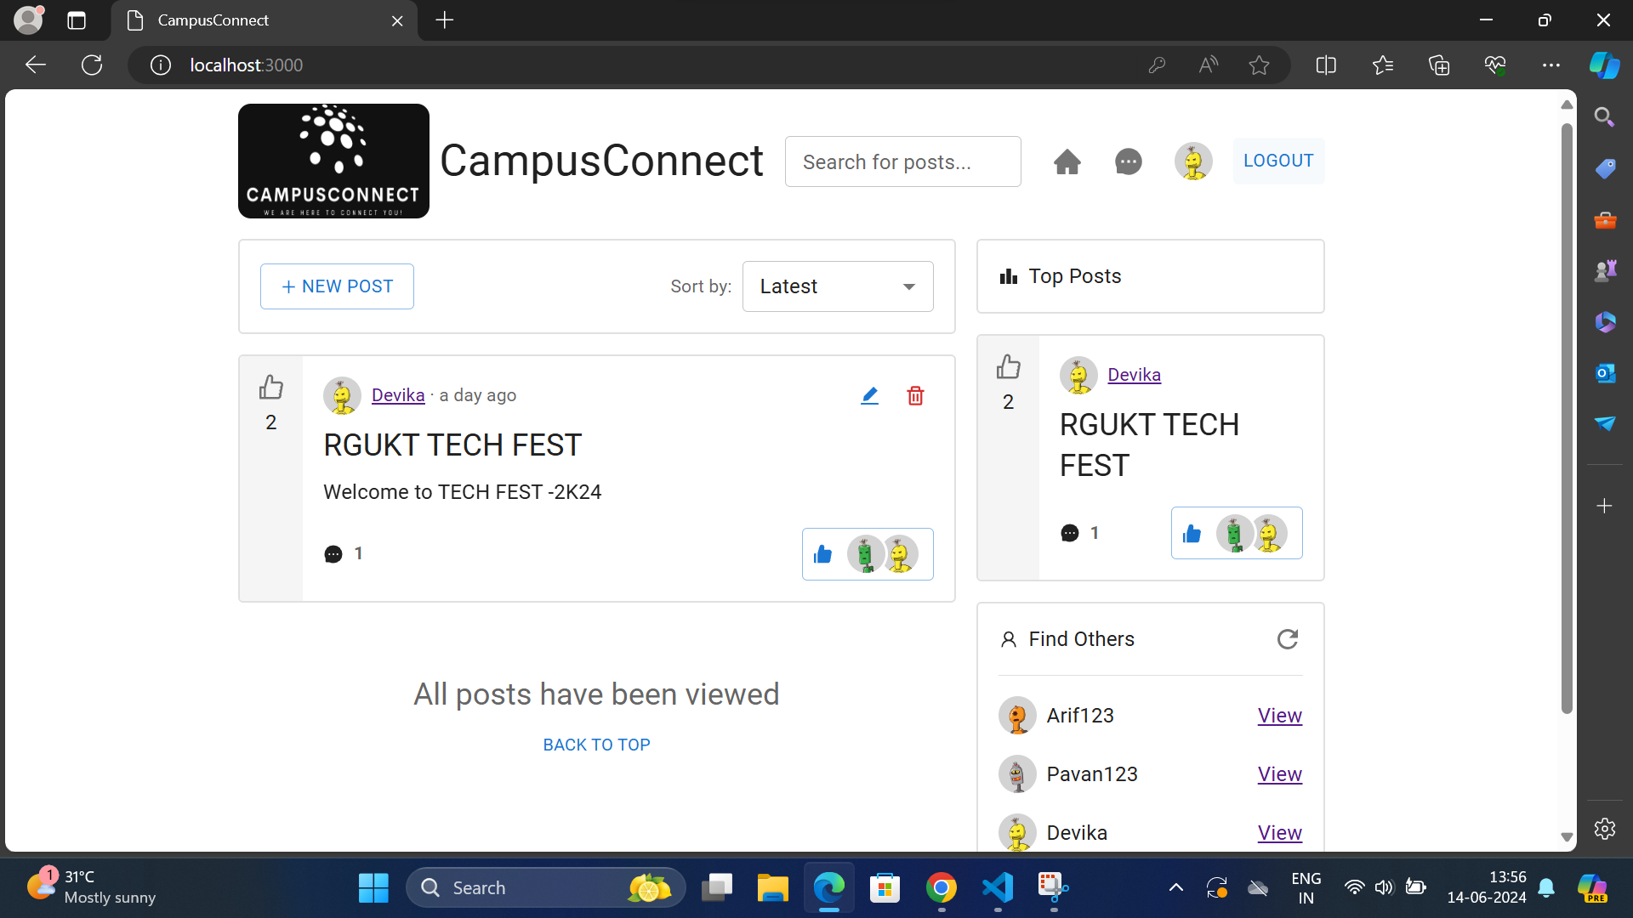
Users are allowed to LOGOUT from the application once they had done with the requirement.

Slide 27
CONCLUSION
The implementation of this web-based system significantly reduces the delays in connecting a campus/community effieciently and fastly.
This improvement enhances the sharing of thoughts,ideas,decisions and feelings/emotions in the form of images,texts,videos i.e POSTS.Which is directly accessible to the Community or a Campus.
Thus this project resolves the problems like delay in communication,one site content accsessible to each and every participant.

Slide 28
thank
you

